Slide 1
Quick Review of Dynamics 1: First Models
April 14, 2020

Slide 2
Epidemics vs Outbreaks
“Epidemic refers to an increase, often sudden, in the number of cases of a disease above what is normally expected in that population in that area. Outbreak carries the same definition of epidemic, but is often used for a more limited geographic area.”
Reference: https://www.cdc.gov/csels/dsepd/ss1978/lesson1/section11.html

Slide 3
Force of Infection
The force of infection (λ) is the rate at which susceptible individuals are infected.
It is a function of the proportion (or number) of infected individuals and the rate at which they infect others
We call this the effective contact rate (β)
λ(t) = βI(t)

Slide 4

Effective Contact Rate (ECR)
The ECR is the the number of infections generated by an infectious person, over a defined period of time (i.e. daily, monthly, yearly) to a susceptible population
ECR is sometimes broken down into multiple components, for example:
$$β=k∗p$$
Where:
k = number of contacts per unit time
p= probability of infection for each contact
“transmission rate” - “product of the contact rates and transmission probability” (Keeling and Rohani)
“effective contact rate” - “the per capita rate at which two specific individuals come into effective contact per unit time” (Vynnycky and White)

Slide 5
Force of Infection, Incidence, Prevalence
Force of infection = λ = βI
Incidence = λS = βSI
Prevalence = I
S
βSI
I

Slide 6
Basic Reproductive Number
The basic reproductive number (R₀) is the average number of infectious individuals generated by a single infectious individual in a fully susceptible population
In the SIR model, R₀ = β/γ or βD, where D= duration of infectiousness
If >1, an epidemic can occur
For an epidemic to begin, the susceptible population has to be greater than 1/R₀

Slide 7
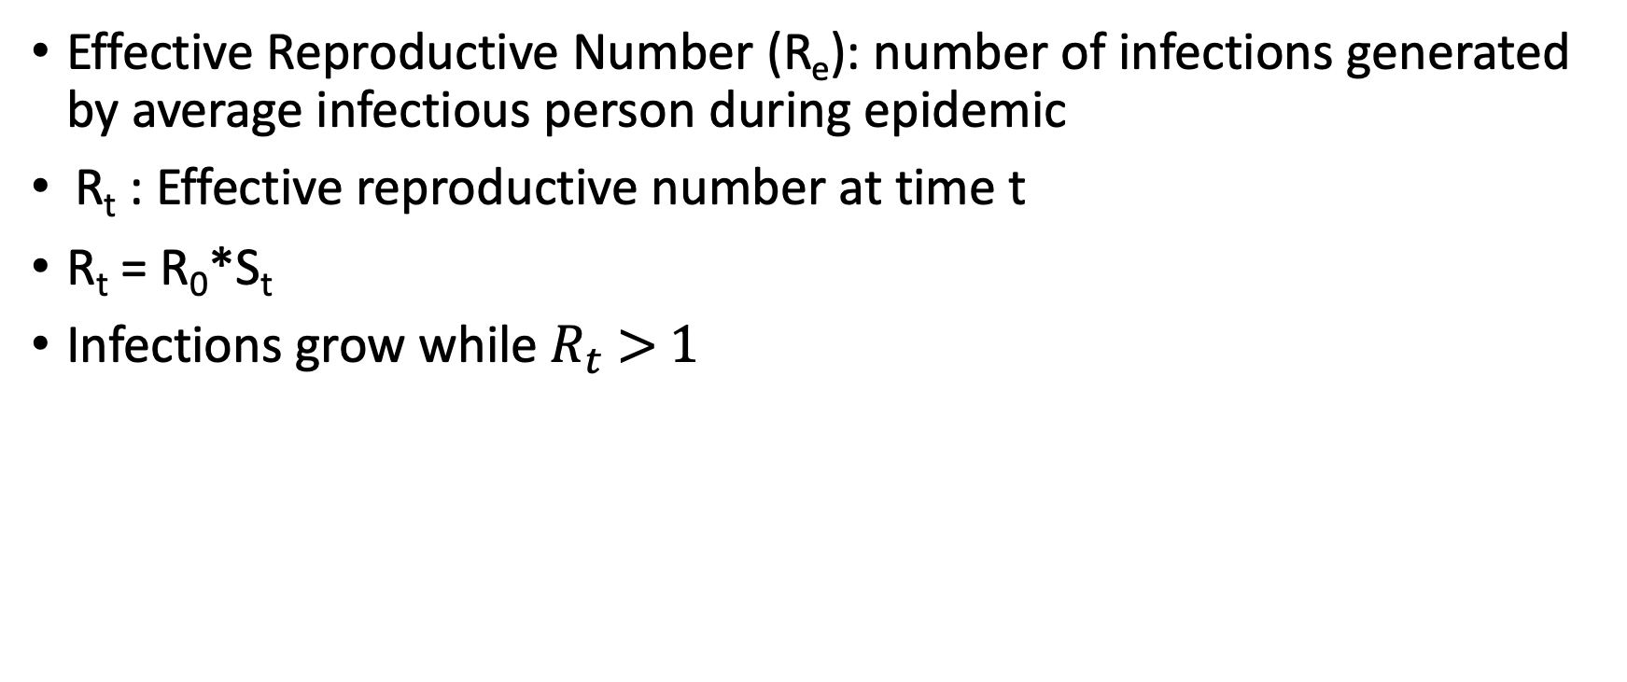
Basic vs Effective Reproductive Number
Effective Reproductive Number (R_{e}): number of infections generated by average infectious person during epidemic
R_{t} : Effective reproductive number at time t
R_{t} = R₀*S_{t}
Infections grow while $R_{t}$ > 1

Slide 8
Concepts Review
If R₀ < 1, an epidemic cannot be sustained; when R_{t} < 1, epidemic declines
The critical threshold for vaccination is the level above which outbreaks can’t occur (1-1/R₀)
The fraction of susceptible individuals is the limiting factor in epidemics, dictates whether they start, and when they end

